Slide 1
Class 16: Game Theory
More game theory examples
Optimizing a unique number game
Use of a Nash equilibrium as a practical tool
Generation of random numbers following an arbitrary distribution

Slide 2

The Prisoner’s Dilemma
Two prisoners committed a crime together. They are separated and cannot talk to each other.
The prosecutor offers each the same deal: confess, become a witness to the prosecution, and no jail time.
If one prisoner confesses while other does not, the first goes free and the second goes to jail for 10 years.
If both confess they will each go to jail for 7 years.
If neither confess they go to jail for 1 year (since nothing can be proven).

Slide 3
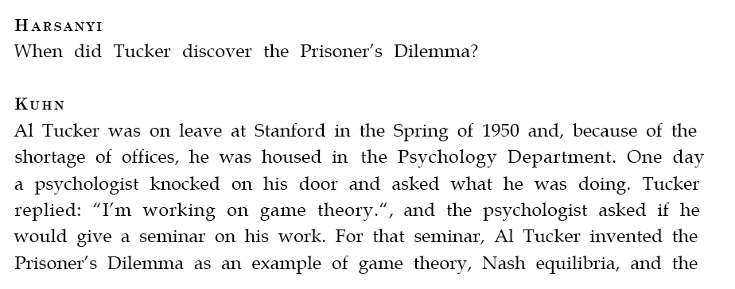

Discovered by Al Tucker, Nash’s PhD advisor

Slide 4
The Prisoner’s Dilemma
 | Remain Silent | Confess
Remain Silent | (-1, -1) | (-10, 0)
Confess | (0, -10) | (-7, -7)
What should they do?

Slide 5
The Prisoner’s Dilemma
Cooperate = remain silent, Defect = confess
 | Remain Silent(C) | Confess (D)
Remain Silent (C) | (-1, -1) | (-10, 0)
Confess (D) | (0, -10) | (-7, -7)
T = 0 (temptation) P = -7 (punishment)
S = -10 (sucker’s payoff) R = -1 (reward)
T > R > P > S

Slide 6
The Prisoner’s Dilemma
Cooperate = remain silent, Defect = confess
 | Remain Silent(C) | Confess (D)
Remain Silent (C) | (-1, -1) | (-10, 0)
Confess (D) | (0, -10) | (-7, -7)
T = 0 (temptation) P = -7 (punishment)
S = -10 (sucker’s payoff) R = -1 (reward)
T > R > P > S
If both cooperate, both get R, which is better than if they both defect, getting P
Temptation is to defect. So both defect yielding a suboptimal outcome. Neither has an incentive to switch – Nash equilibrium
Notes:
R > P (mutual cooperation is preferred to mutual defect)
T > R, P > S (defection is the dominant strategy)

Slide 7
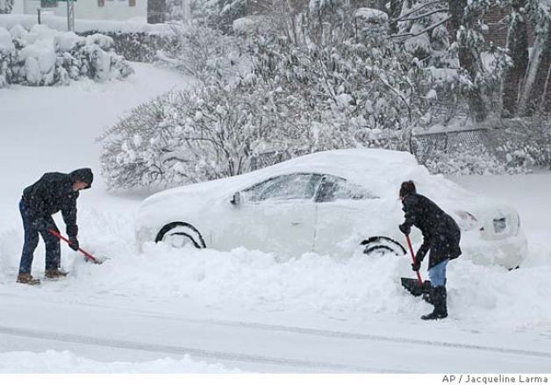
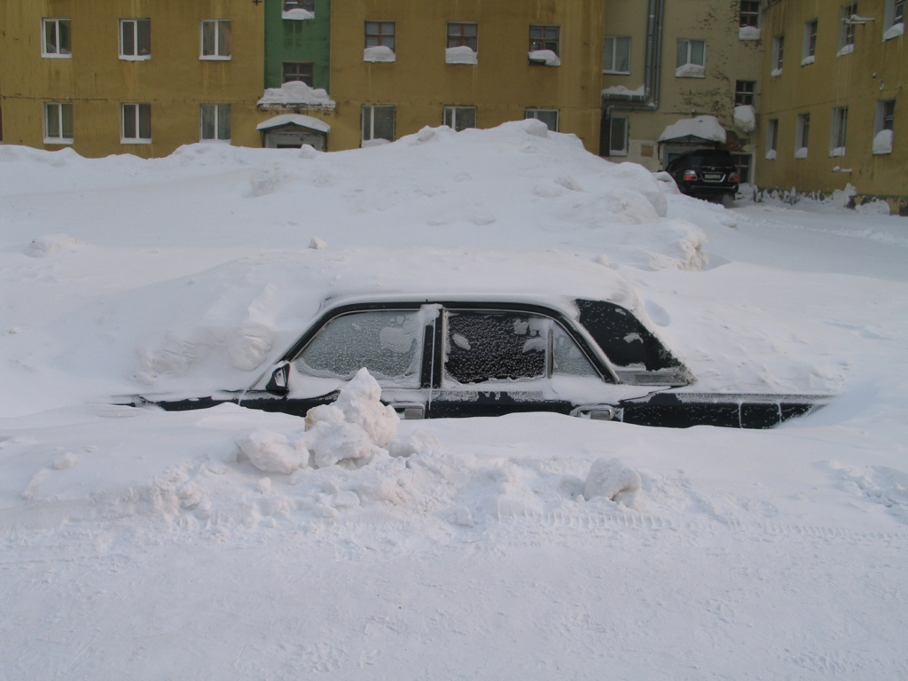
Snowdrift Game
Cooperate = shovel
Defect = don’t shovel
Notes:
The situation of the Snowdrift game involves two drivers who are trapped on opposite sides of a snowdrift. Each has the option of staying in the car or shoveling snow to clear a path. Letting the opponent do all the work is the best option (with a pay-off of 300 used in this study), but being exploited by shoveling while the opponent sits in the car still results in a pay-off of 100. (The other two possibilities, both shoveling and both sitting, have pay-offs of 200 and 0, respectively.)
Read more at: https://phys.org/news/2007-10-snowdrift-game-tops-prisoner-dilemma.html#jCp

Slide 8
Snowdrift Game
Cooperate = shovel
Defect = don’t shovel
T = Temptation
P = Punishment
S = Sucker’s payoff
R = Reward
 | (C) | (D)
(C) | (R, R) | (S, T)
(D) | (T, S) | (P, P)
Compare the relative sizes of T, P, R, S
Notes:
T > R > S > P

Slide 9
Snowdrift Game
Cooperate = shovel Defect = don’t shovel
T = Temptation
P = Punishment
S = Sucker’s payoff
R = Reward
 | (C) | (D)
(C) | (R, R) | (S, T)
(D) | (T, S) | (P, P)
T > R > S > P
If both cooperate, both get R, which is better than if they both defect, getting P
If other player defects, it’s still better to cooperate.
Best option is the opposite of other
Notes:
T > R > S > P

Slide 10
Repeated Prisoner’s Dilemma (Axelrod, Hamilton, 1981)
Cooperate = remain silent, Defect = confess
 | Remain Silent(C) | Confess (D)
Remain Silent (C) | (-1, -1) | (-10, 0)
Confess (D) | (0, -10) | (-7, -7)
T = 0 (temptation) P = -7 (punishment)
S = -10 (sucker’s payoff) R = -1 (reward)
T > R > P > S
What if the prisoners find themselves arrested again? What would they do?
What would you do if you were playing this game repeatedly, fearing retaliation?
Notes:
If game is played N times and both players know this, then it is always game theoretically optimal to defect.
Cooperate on the first round. Then for the next round, do what opponent did on the previous round.

Slide 11
Repeated Prisoner’s Dilemma vs Repeated Snow Drift Game
https://phys.org/news/2007-10-snowdrift-game-tops-prisoner-dilemma.html

Slide 12
Invent a game?

Slide 13
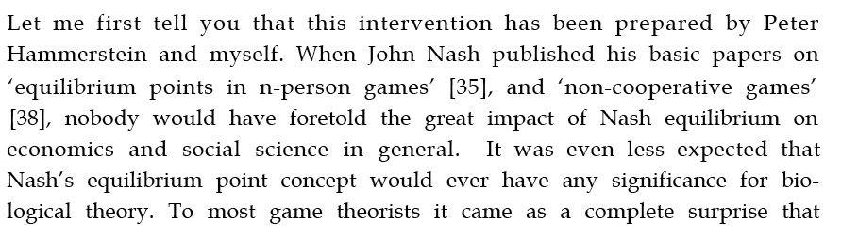
Applications to Biology
Maynard Smith, in the preface to Evolution and the Theory of
Games, writes, “paradoxically, it has turned out that game theory
is more readily applied to biology than to the field of economic
behavior for which it was originally designed.”

Slide 14
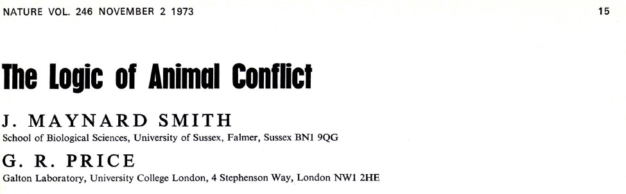
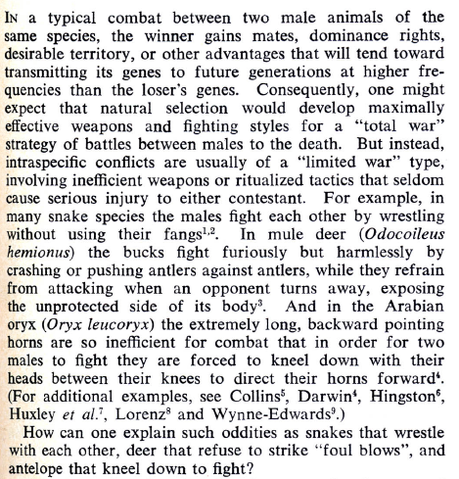
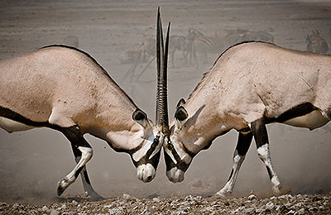
Lab: part 1

Slide 15
The unique number game
Take n players
They each choose an integer from 0 to 99
The person who chose the lowest unique number wins

Slide 16
Two example games with five players
Player | A | B | C | D | E
Choice | 0 | 4 | 3 | 2 | 0
Player D wins
Player | A | B | C | D | E
Choice | 0 | 3 | 3 | 0 | 0
No unique number – draw

Slide 17
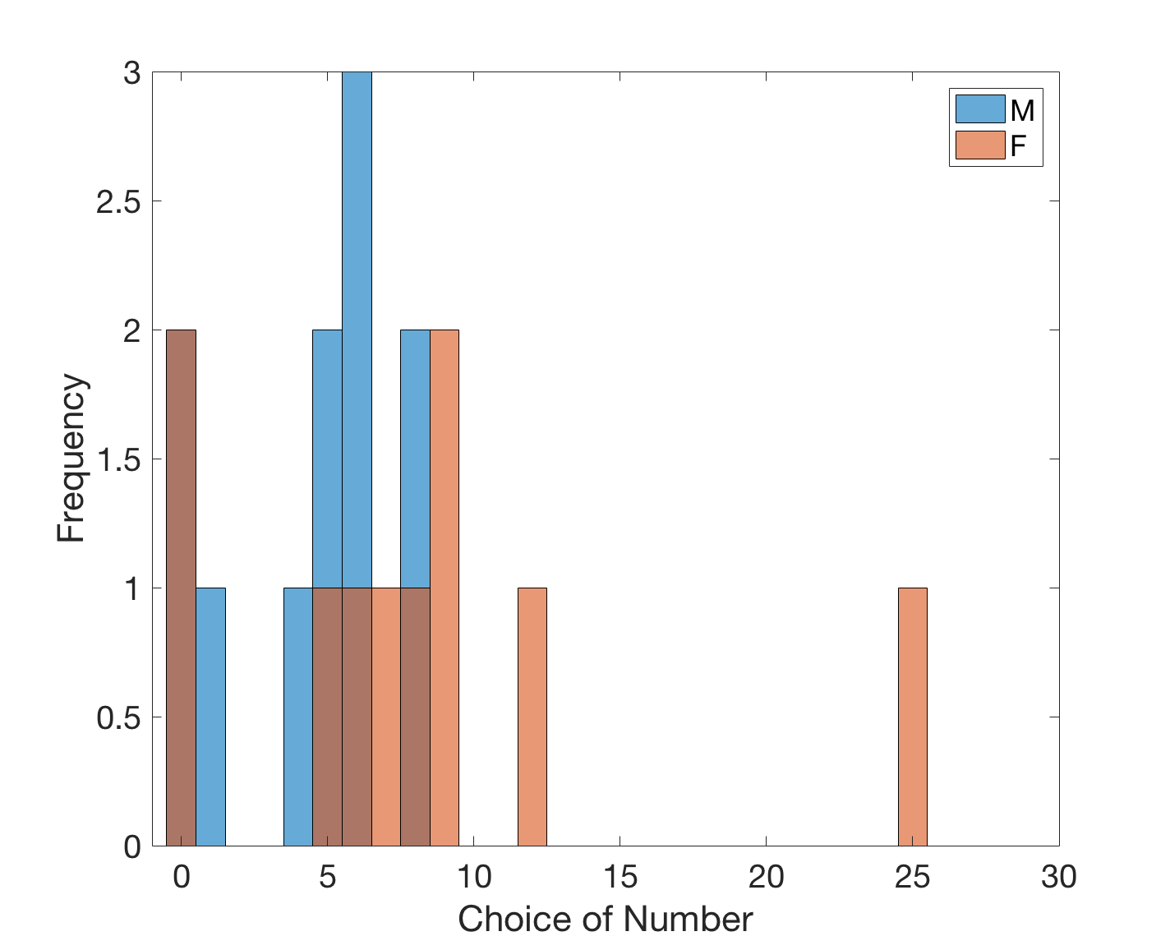
Results of our game
Jacob Bindman
mean (F) = 8
sigma (F) = 7
mean (M) = 4
sigma (M) =3

Slide 18
Let’s play again
Does your strategy change?

Slide 19
The AM 50 Competition!
We are going to play many repeated unique number games
There will be (likely) 100 sets of ten million rounds, making (likely) 1,000,000,000 rounds in total
Homework problem 1: write a Matlab function to implement strategy for these repeated games
Playing a pure strategy may be problematic; a mixed strategy may be advantageous

Slide 20
From upcoming lab: uniform random up to some number
Choose numbers randomly over a reasonable range
r = randi([0,25], 1);

Slide 21
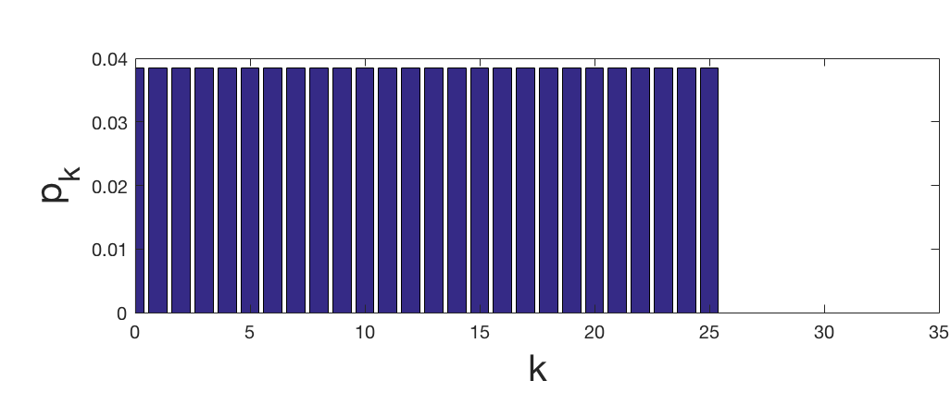
From upcoming lab: uniform random up to some number
Choose numbers randomly over a reasonable range
Easily beaten
Key problem: does it really make sense to choose 25 with the same probability as 0?
r = randi([0,25], 1);

Slide 22
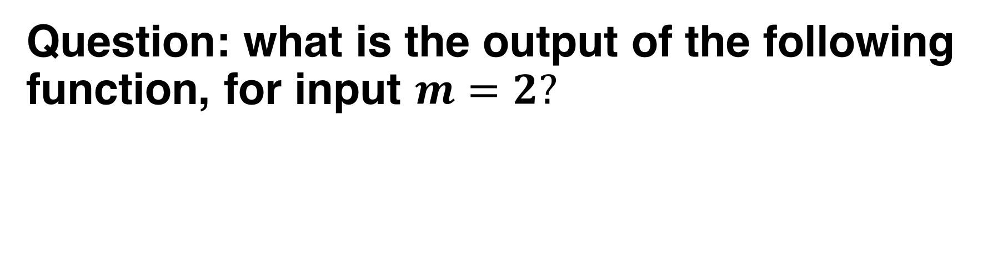
A simple weighted random strategy
Question: what is the output of the following function, for input $m=2?$
function r = playgame(m)
j = randi([0, m], 1);
r = randi([0,j], 1);
end

Slide 23
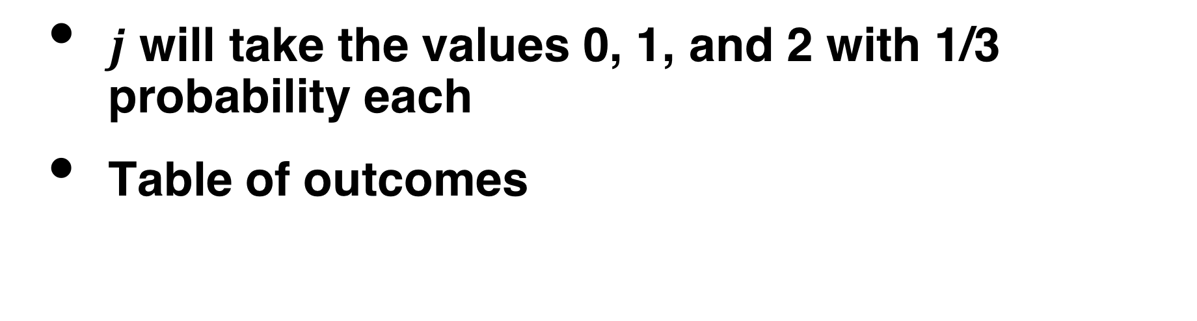
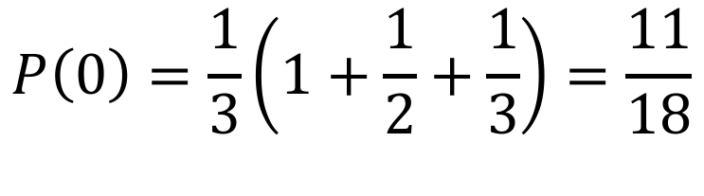
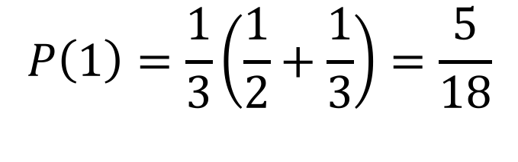
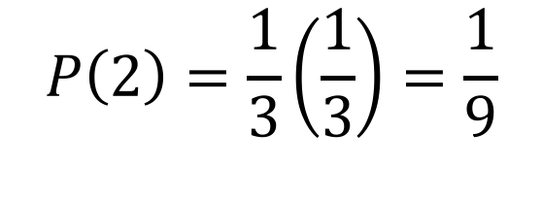
Probabilities
$j$ will take the values 0, 1, and 2 with 1/3 probability each
Table of outcomes
Result | Prob. if j = 0 | Prob. if j = 1 | Prob. if j = 2
0 | 1 | 1/2 | 1/3
1 |  | 1/2 | 1/3
2 |  |  | 1/3
$$P\left(0\right)=\frac{1}{3}\left(1+\frac{1}{2}+\frac{1}{3}\right)=\frac{11}{18}$$
$$P\left(1\right)=\frac{1}{3}\left(\frac{1}{2}+\frac{1}{3}\right)=\frac{5}{18}$$
$$P\left(2\right)=\frac{1}{3}\left(\frac{1}{3}\right)=\frac{1}{9}$$

Slide 24
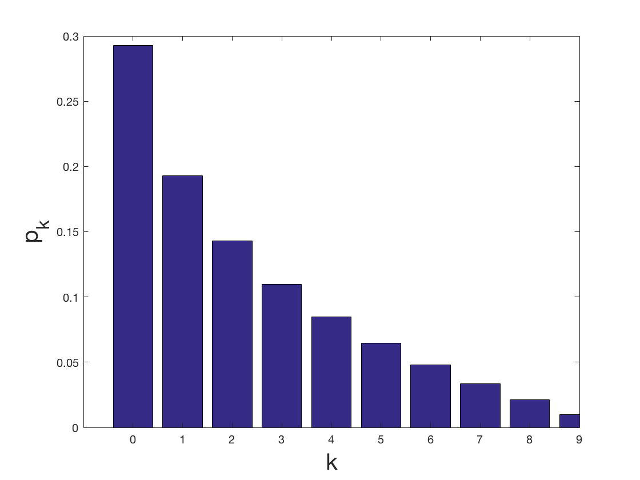

Calculating the probabilities
$$m=9$$

Slide 25
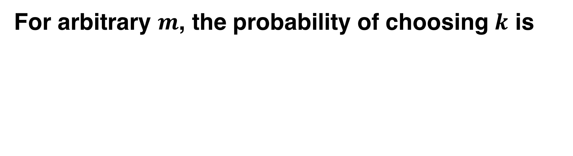
Calculating the probabilities
For arbitrary $m$, the probability of choosing $k$ is

Slide 26
Random sampling: Matlab

Slide 27
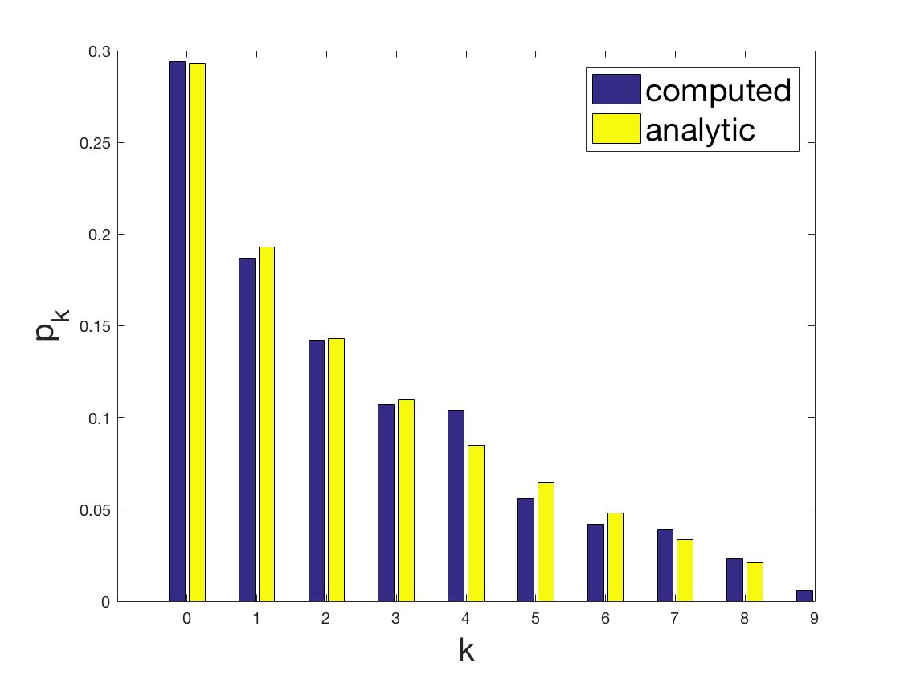
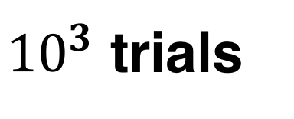
Random sampling
${10}^{3}$ trials

Slide 28
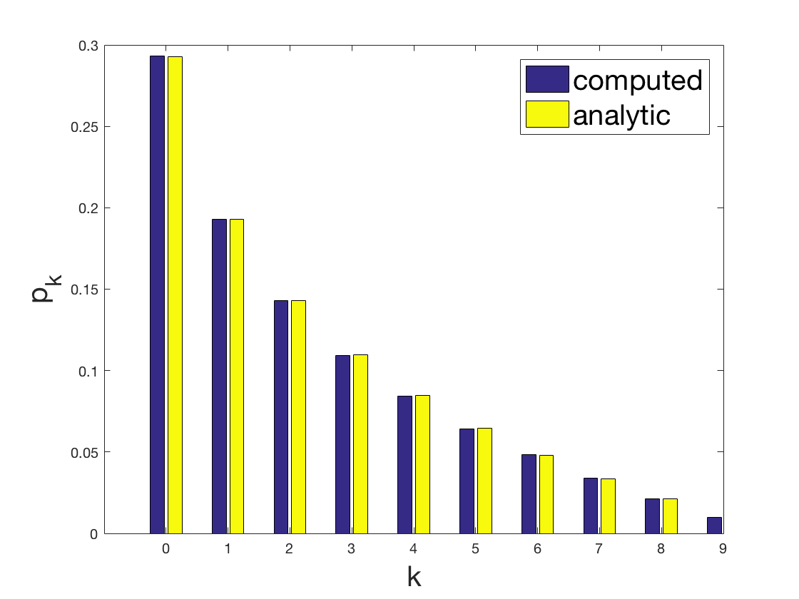
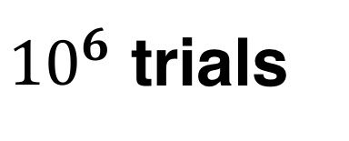
Random sampling
${10}^{6}$ trials

Slide 29
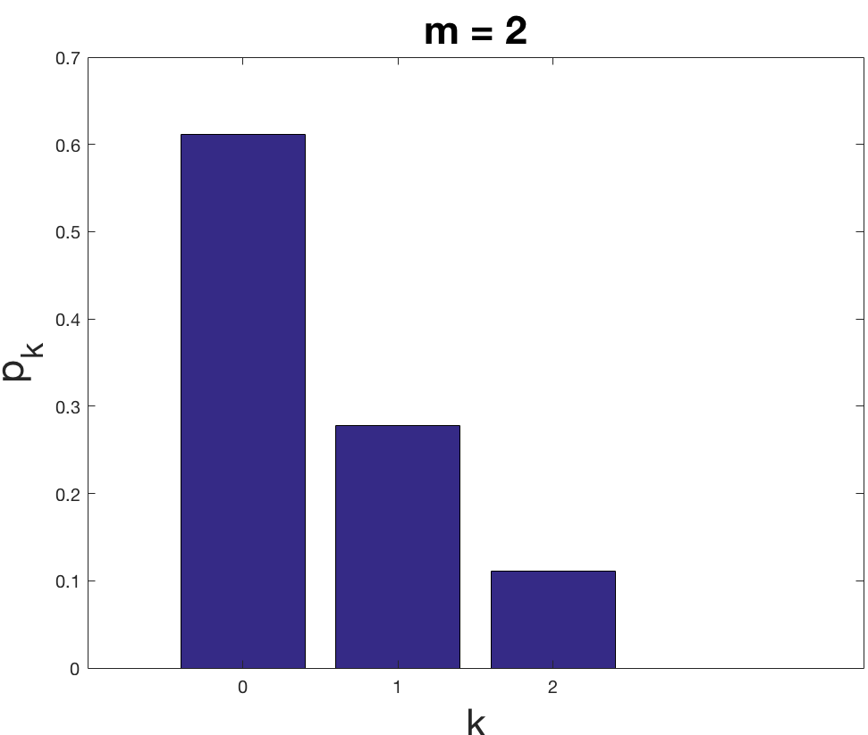
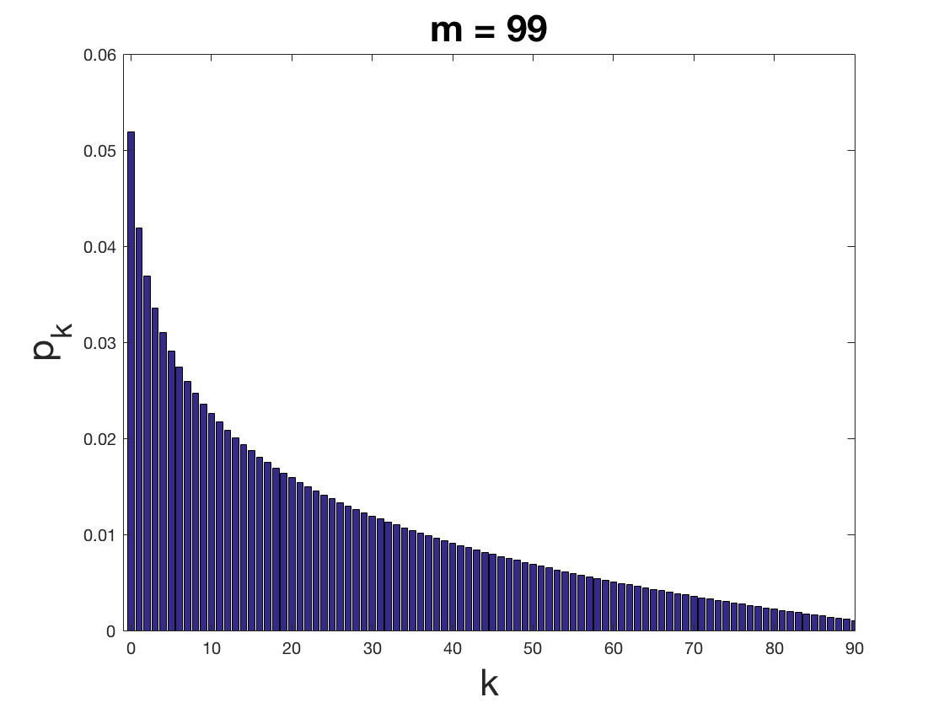

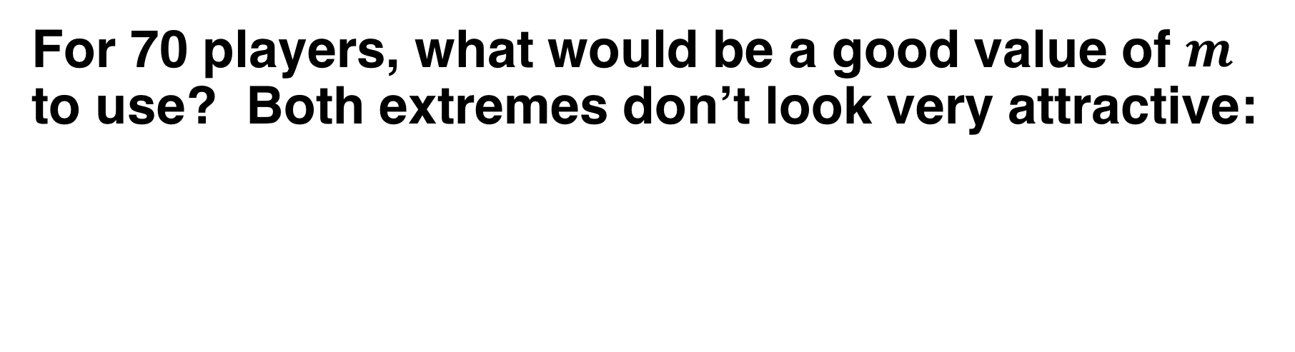
Finding an optimal value of $m$
For 70 players, what would be a good value of $m$ to use? Both extremes don’t look very attractive:
0,1,2 likely to be eliminated in 70-person game
High numbers played too often; 80 is unlikely to ever win

Slide 30
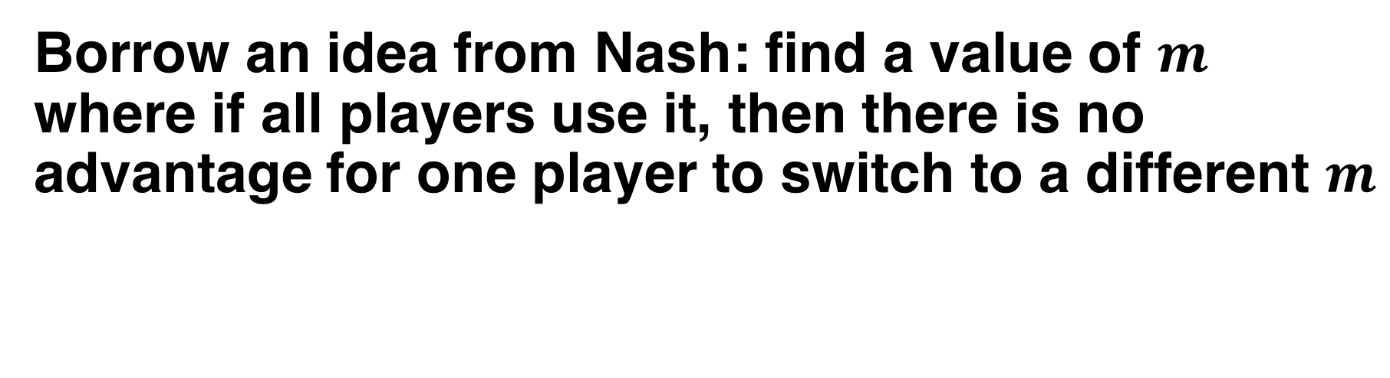
Finding an optimal value of $m$
Borrow an idea from Nash: find a value of $m$ where if all players use it, then there is no advantage for one player to switch to a different $m$

Slide 31
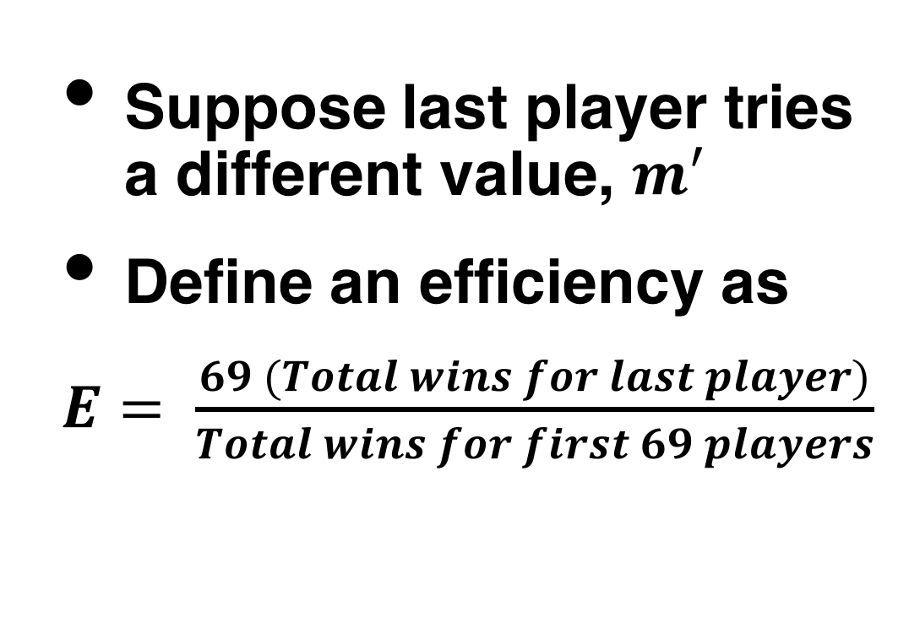
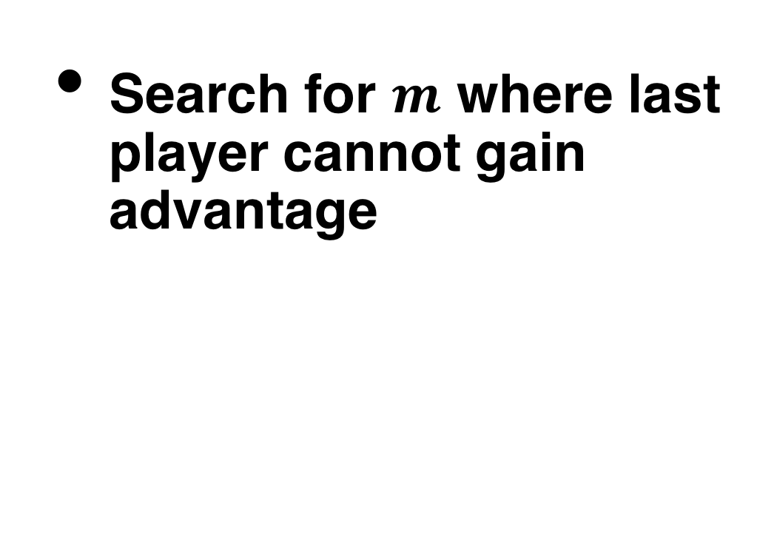
Optimization results for 70 players
Suppose last player tries a different value, $m′$
Define an efficiency as
$E= \frac{69 (Total wins for last player)}{Total wins for first 69 players}$
Search for $m$ where last player cannot gain advantage

Slide 32
Optimization results for 70 players
Suppose last player tries a different value, $m′$
Define an efficiency as
$E= \frac{69 (Total wins for last player)}{Total wins for first 69 players}$
Search for $m$ where last player cannot gain advantage

Slide 33
A more refined search
Once we’re in the right ballpark, we can progressively refine the search by using more trials
Four million trials for each test
One hundred million trials for each test

Slide 34
Optimality of this solution
If players were limited to choosing these strategies, then a value of m = 28 would be a Nash equilibrium: no player can gain advantage by altering his/her value of m
Choosing values up to 28 seems fairly reasonable
It also beats the strategy of always playing zero
However some strategies can still win against it

Slide 35
Some things to consider in designing a unique number strategy
If you have a probability distribution in mind, there are routines (bisection) that can be used to rapidly create random samples from this distribution
Other things to consider:
Adaptivity: you know what other players did in previous rounds
Introspection: you know how well your previous strategies worked out

